Slide 1
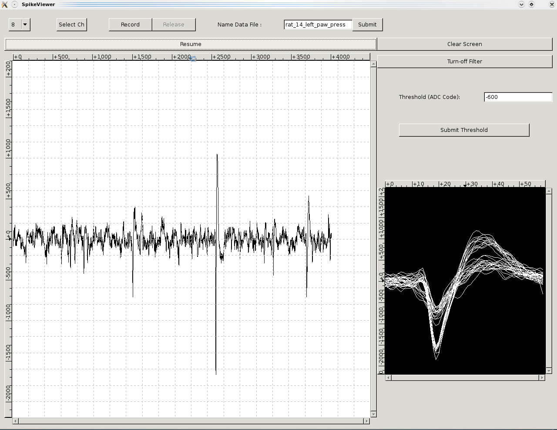
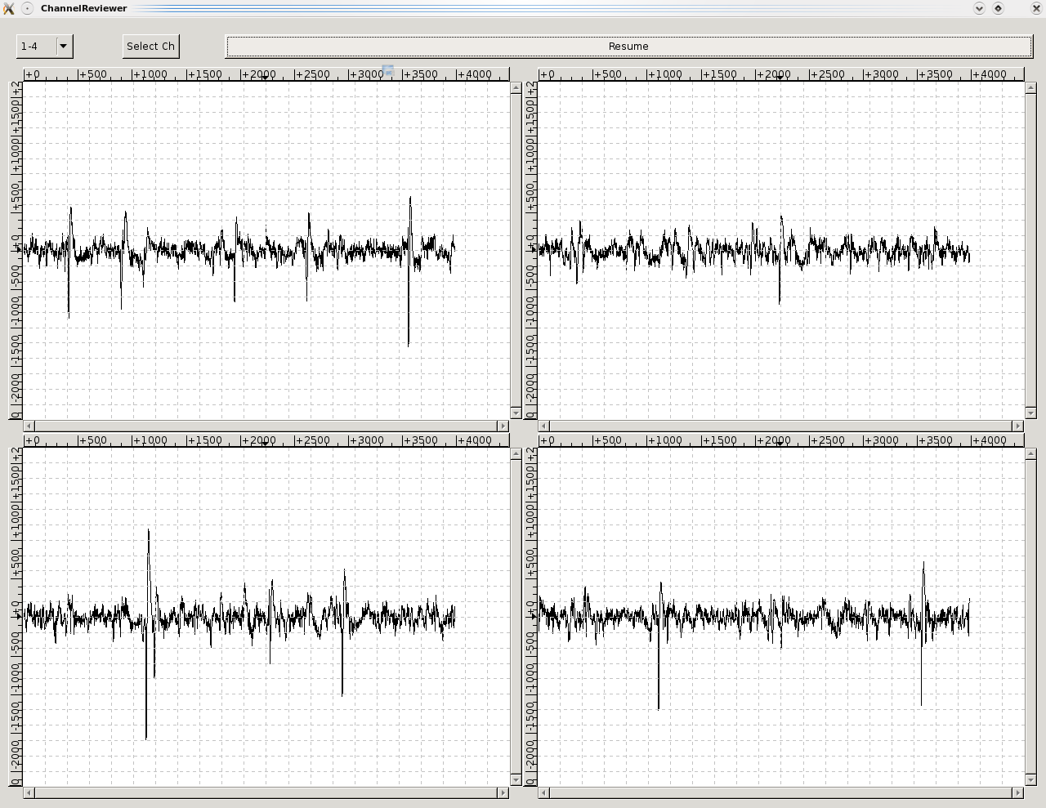
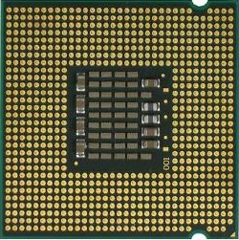

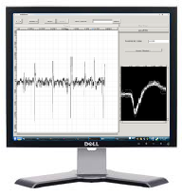
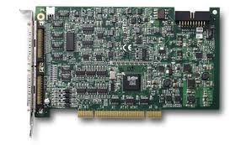
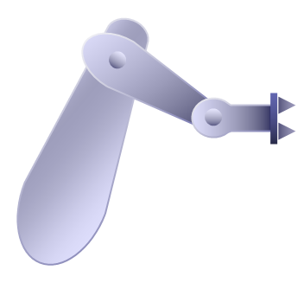

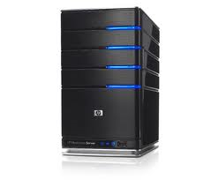
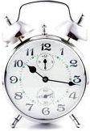

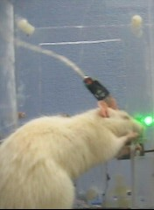



A Real-time Data Acquisition and Neural Spike Processing Platform for Brain Machine Interface Engineering Experiments
M. KOCATURK¹, H. O. GULCUR¹, R. CANBEYLI²
¹Institute of Biomedical Engineering, ²Department of Psychology, Bogazici University ,Istanbul, Turkey
819.24/OOO74
Introduction
Software Architecture
The ChannelReviewer
The SpikeViewer
A critical task in brain machine interface (BMI) studies is acquiring multi-unit activity at adequate sampling rates and processing the digitized data in real-time to provide communication between the nervous system and the neural prosthesis.
In the present work, we introduce a real-time data acquisition and processing system as a cost-effective and practical platform for BMI research.
The management of data acquisition, neural spike detection and recording is performed by the developed open source software and Graphical User Interface(GUI).
Sixteen channel data sampled at 40 KHz are buffered at a shared memory location made accessible to all the tasks running on different processors. One core of the CPU is dedicated to management of data acquisition while the others are used for data processing and other tasks.
Running of time-critical tasks in kernel space provides less jitter and latency. The tools for experiment management and configuration tools are designed to run in user space.
The ChannelReviewer, GUI to visualize multiple spike channels with a refresh rate of 10 fps, is especially useful during implantation of microwire arrays to ensure placement of the microwire array in the targeted brain structure.
The ChannelReviewer
The SpikeViewer enables the visualization of the spike shapes for the spikes higher than an adjusted threshold. This feature provides the observation of spike shapes for spike sorting.
The digital high-pass filter with a cut-off frequency of 150 Hz running in kernel-space is controlled by SpikeViewer.
Recording of data can be initiated/finalized by using the SpikeViewer. A user defined phrase can be appended to the data file name which is automatically generated according to date and time of recording.
Scheduled Task #0
(Timer: 1ms)
Scheduled Task #1
(Timer: 20 ms)
Data Acquisition
&
Spike Detection
Communication with the Experimental Environment
Core #0
Core #1
Virtual CPU 0
Virtual CPU 1
Virtual CPU 2
Virtual CPU 3
Infrastructure for a Closed-Loop BMI Experiment Setup
The system consists of a computer equipped with a multi-core CPU, a data acquisition card and the Linux operating system with RTAI extension for real-time operation (Real-Time Application Interface, www.rtai.org). The drivers and libraries developed by the COMEDI Project (Linux Control and Measurement Devices Interface, www.comedi.org) are used for facilitating management of the data acquisition hardware.
Core #2
Core #3
Library to Build GUIs
Virtual CPU 4
Virtual CPU 5
Virtual CPU 6
Virtual CPU 7
Scheduled Task #2
Scheduled Task #3
Recorded Data for a Behavioral Experiment
Spike Sorting
Model Computation
Five channel data recorded from rat motor cortex forelimb area [1,2].
A nose poke of the rat through infra-red beam initiates a trial (green bar) and a lever press with forepaw (red bar) contralateral to the implantation area in the brain leads to delivery of water as reward.
Data Acquisition Card
Experimental Environment with
Neural Prosthesis
Conclusions
In vivo
Data Acquisition
Random Access Memory
Spike Amplitude(mV)
The latency in acquisition is less than 80 microseconds for an external trigger and less than 1.7 milliseconds for an internal trigger generated by the software according to our tests performed by a PC utilizing Intel i7 930 CPU and NI PCI-6070E DAQ card. Based on our in vivo experiments on the rat motor cortex, we intend to improve the system by inclusion of an online spike sorting facility.
Addition of new features is feasible without any compromise in real-time processing performance since shared memory approach is adopted in this system design.
Computer
(Multi-Core CPU, RTAI)
Serial Communication with
Experimental Environment
(RS-232)
User Space
(Non-Real Time Tasks)
Management of DSP
(Digital Signal Processing)
Adjustments
for
Spike Detection
Visualization of
Acquired Data
Data Recording
Infrastructure for the Management of BMI Experiments.
Kernel Space
(Real Time Tasks)
Data Acquisition
Digital Filtering
Spike Detection
Duration (s)
Trial Onset
Lever Press
References:
[1] Hyland, B., Neural activity related to reaching and grasping in rostral and caudal regions of rat motor cortex, Behav Brain Res., 94(2):255-69, 1998.
[2] Kleim, J.A., Barbay, S., Nudo, R.J., Functional reorganization of the rat motor cortex following motor skill learning , J Neurophysiol., 80: 3321-3325, 1998.
Acknowledgements:
Supported by Bogazici University BAP Grant #5155.

